Slide 1

DynamoDB operations from EC2 & nginx
Ankita Phadke
04/27/23

Slide 2
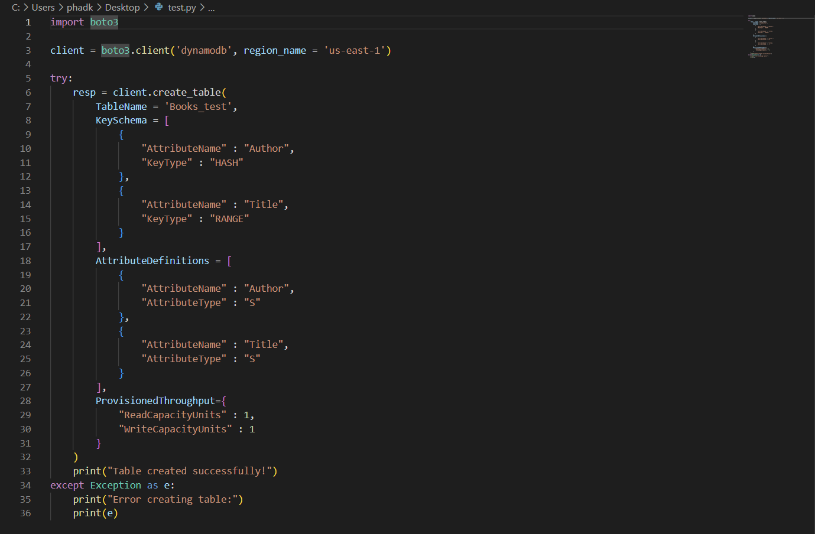
DynamoDB table creation
Inside VSCode

Slide 3
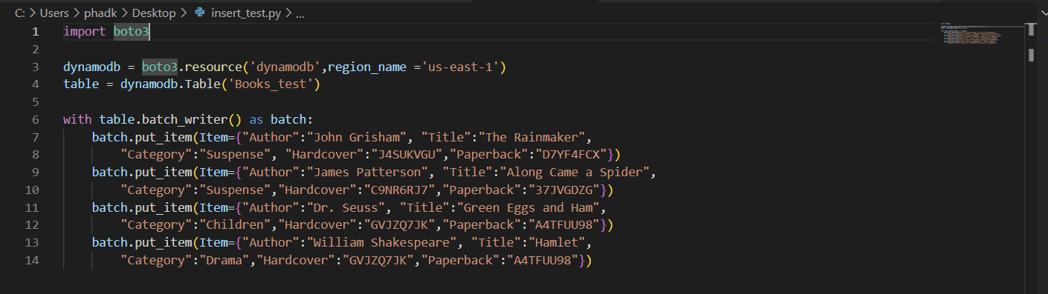
DynamoDB data insertion into table

Slide 4
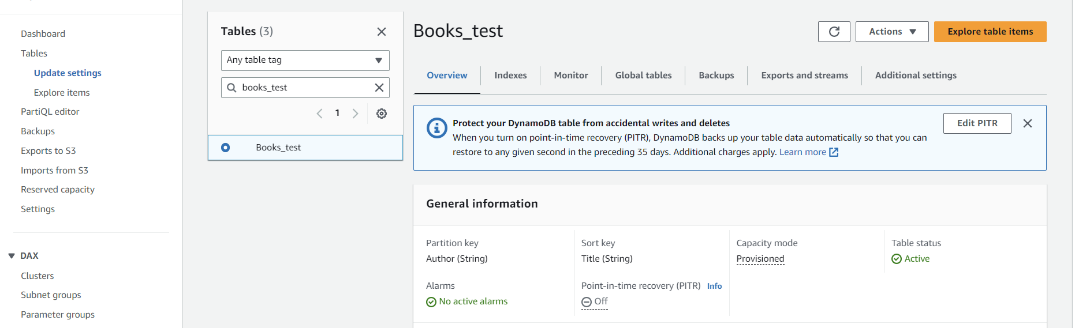
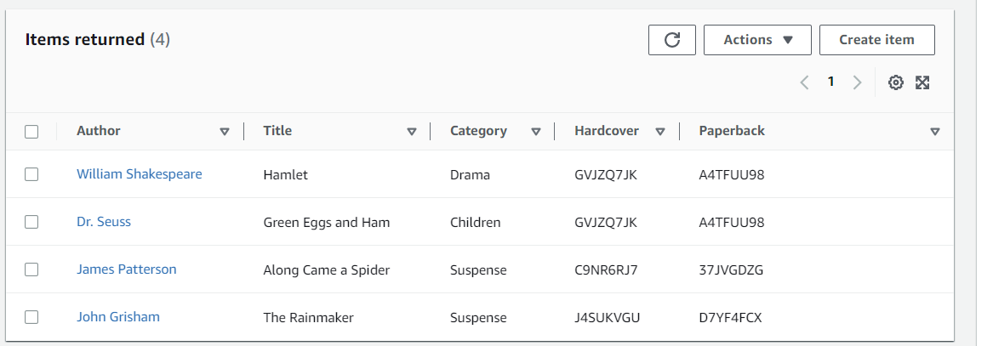
DynamoDB table structure & data
Inside AWS

Slide 5
Accessing DynamoDB table using nginx on EC2
To do: Install nginx in an EC2 and edit the html file so it can query the dynamodb you created. Call it from a browser to query an item in the DynamoDB.

Slide 6
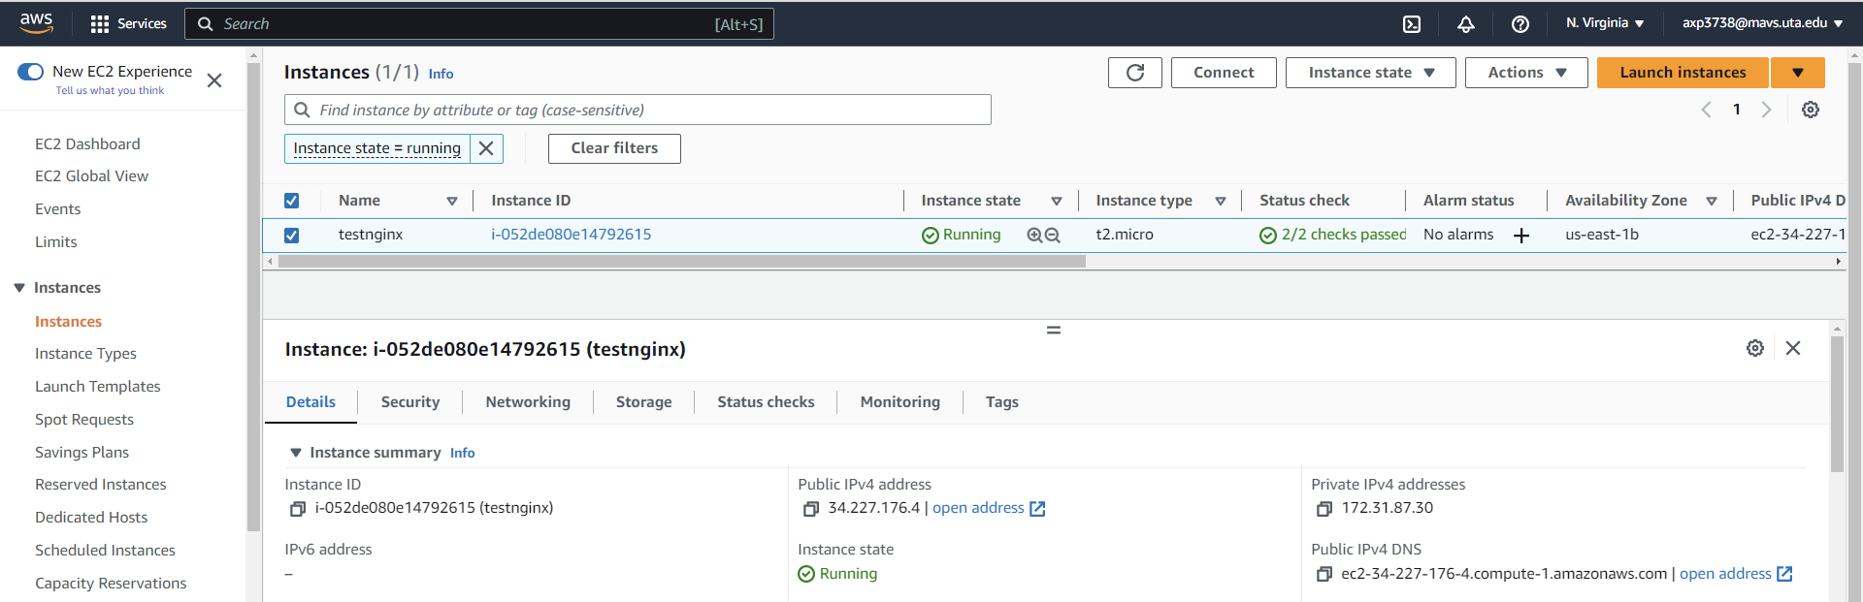
Accessing DynamoDB from nginx
Power on the EC2, connect to EC2 using AWS Connect option
Inside AWS

Slide 7
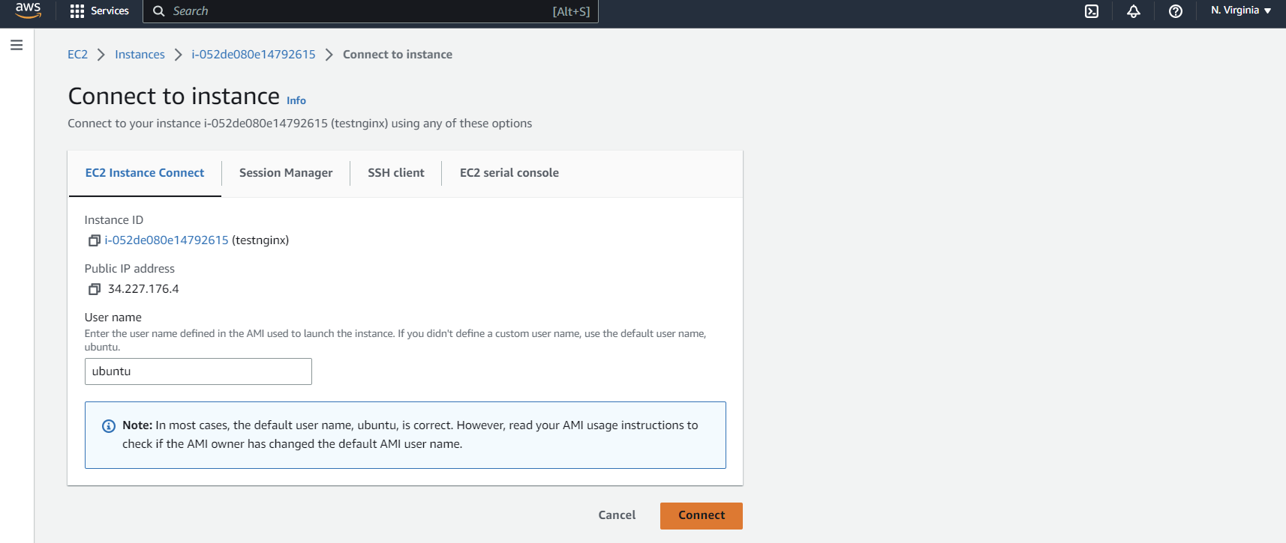
Accessing DynamoDB from nginx
Connect to EC2 using AWS ‘Connect to Instance’ option
Inside AWS

Slide 8
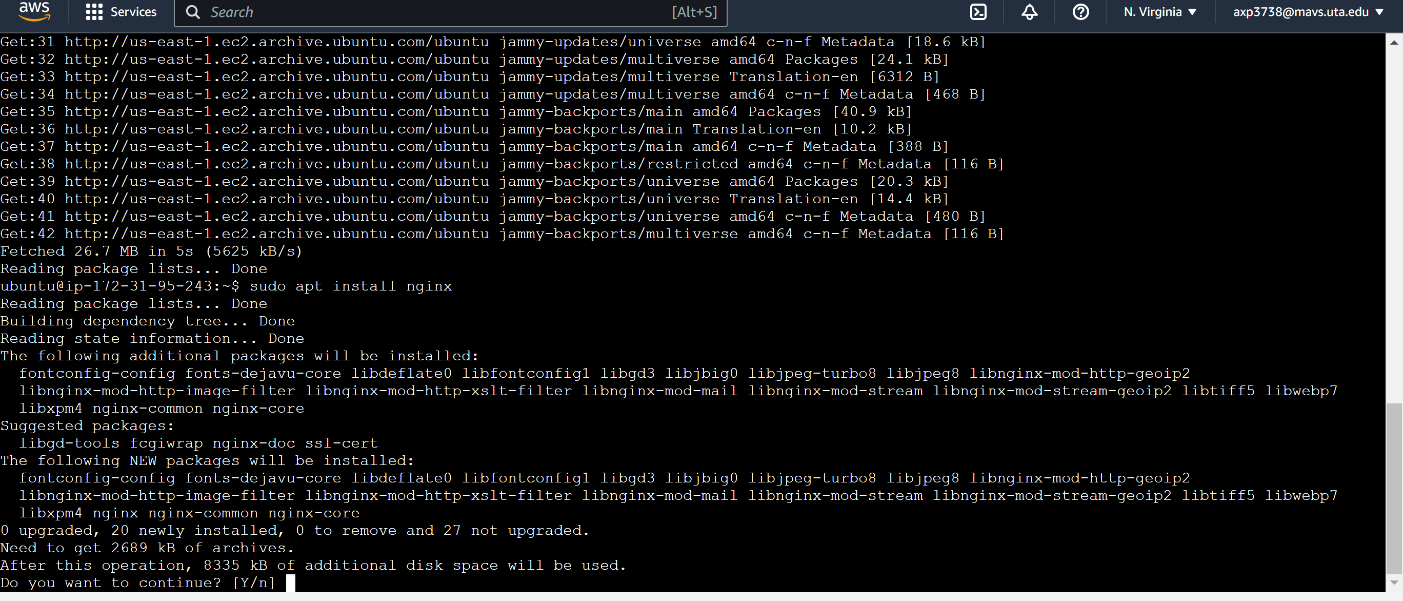
Accessing DynamoDB from nginx
Install nginx on EC2 using ubuntu command
Inside AWS

Slide 9
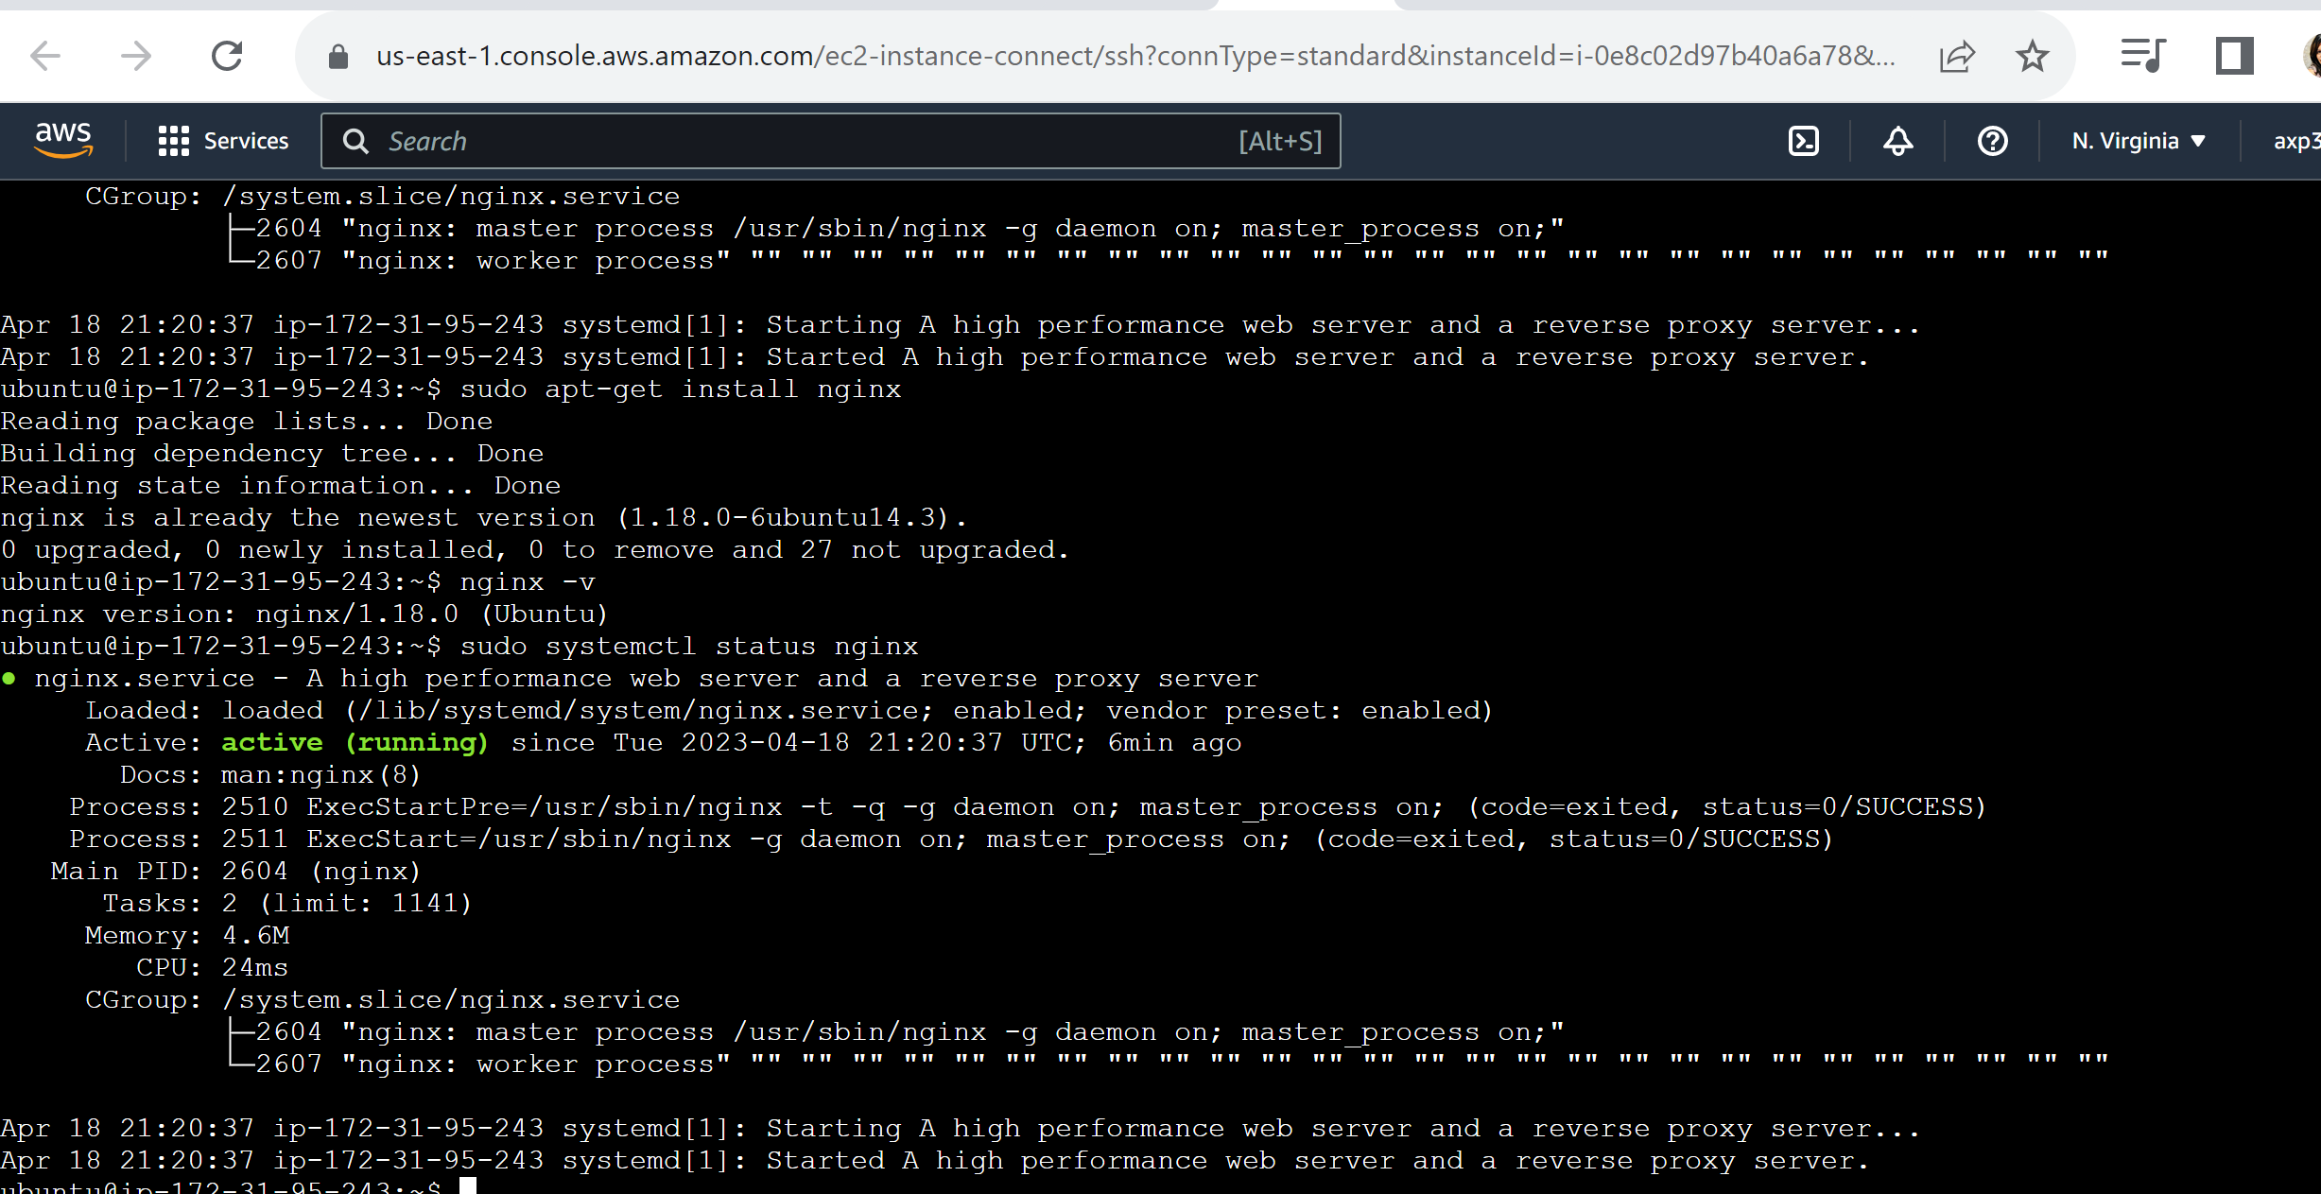
Accessing DynamoDB from nginx
Verify that nginx is running successfully
Inside AWS

Slide 10
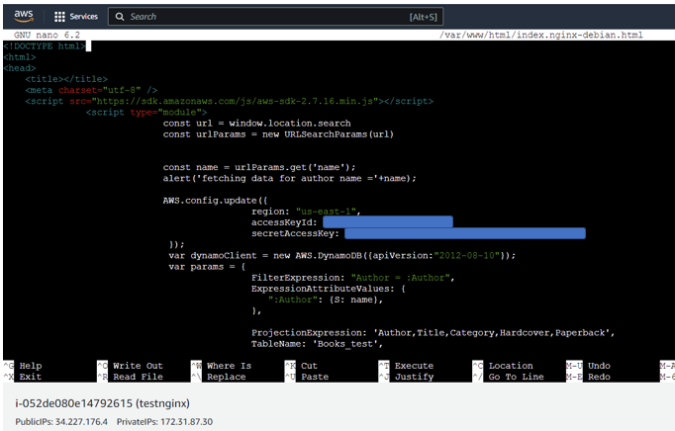
Enter HTML to connect to DynamoDB – part1
Inside AWS
(EC2 nginx)
1.
1. Import the AWS SDK
Javascript file
2. Get the request parameter
from the browser URL
(author name in our case)
3. Update AWS Config – enter
Region, access & secret access
Key
4. Create DynamoDB API object
5. Note the public IP address to
run inside the browser
2.
3.
4.

Slide 11
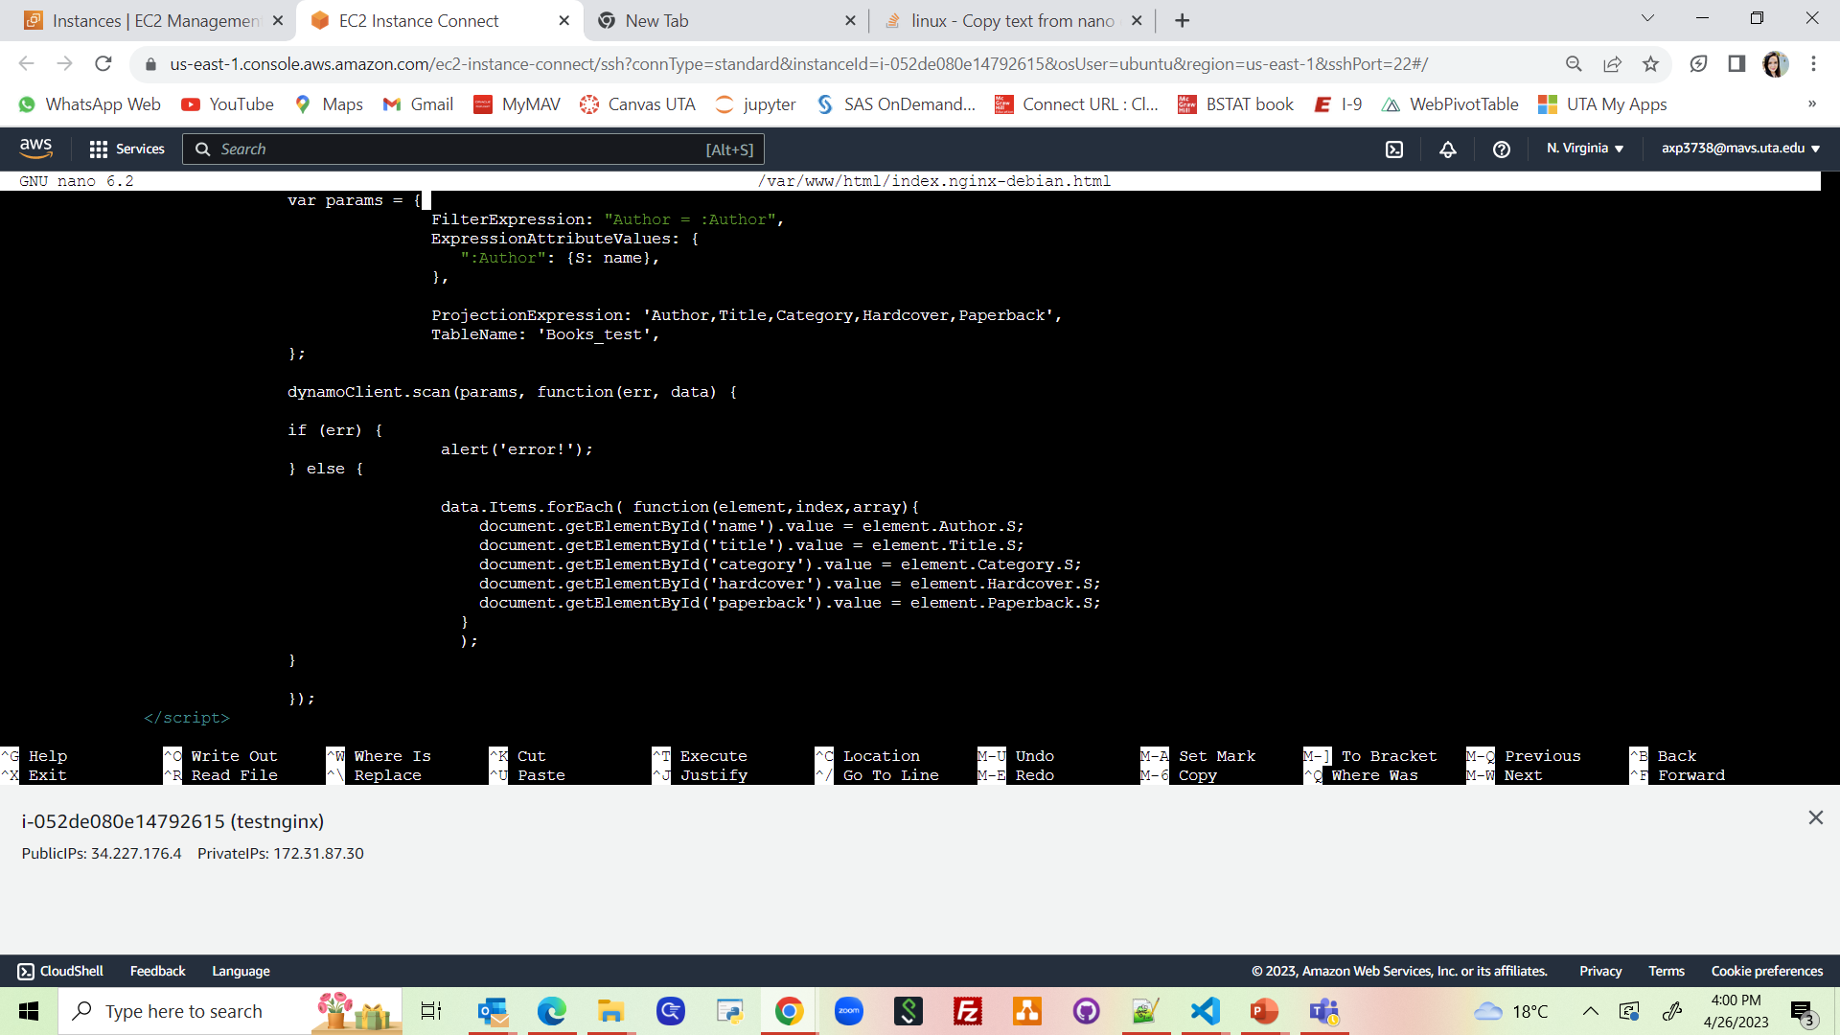
Enter HTML to connect to DynamoDB - part 2
Inside AWS
(EC2 nginx)
5. Enter parameters
FilterExpression (author name)
ExpressionAttributeValues
ProjectionExpression (columns data to be retrieved)
TableName
6. Run the scan function and fetch the data
7. Set the field values into corresponding HTML page values
5.
6.
7.
HTML field id’s inside <body> tag
DynamoDB table column names

Slide 12
Enter HTML to connect to DynamoDB – (explained)
The DynamoDB column based on which data is to be filtered (author name for which data is to be retrieved)
Enter all the column names to be selected from the DynamoDB table
These 2 names should match with each other
‘name’ from step#2
Type is String so enter ‘S’
Enter the table name here

Slide 13
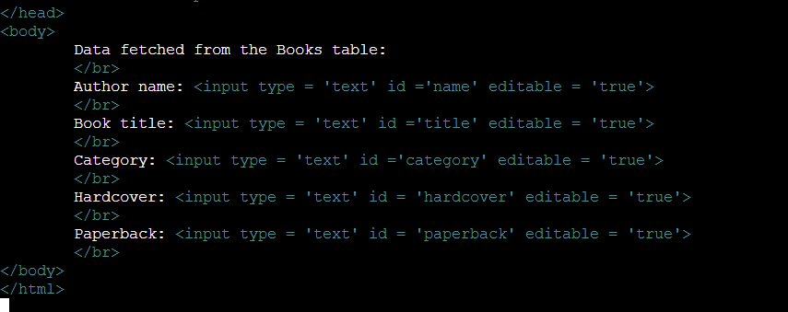
Enter HTML to connect to DynamoDB – part 3
Inside AWS
(EC2 nginx)
Inside the HTML body tag, set the field
ids for each of the fields in table, so that
those can be mapped with the script
field names in above screenshots

Slide 14
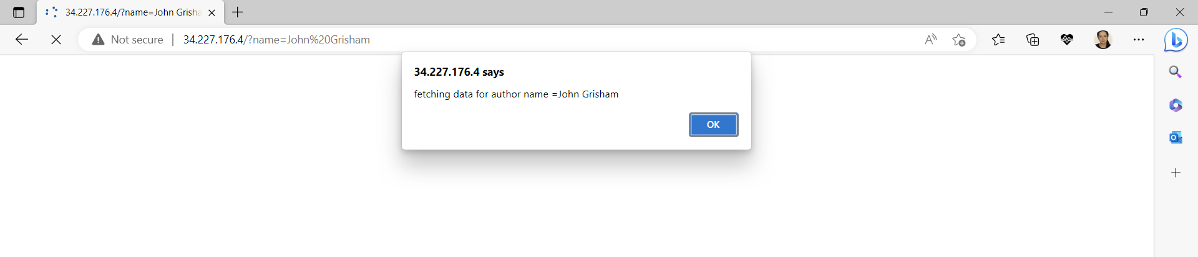
Browser shows the output of DynamoDB scan
On browser
Type the public IP address & append the parameter ‘name’ & the value ‘John Grisham’
URL:
34.227.176.4/?name=John Grisham
Public IP address

Slide 15
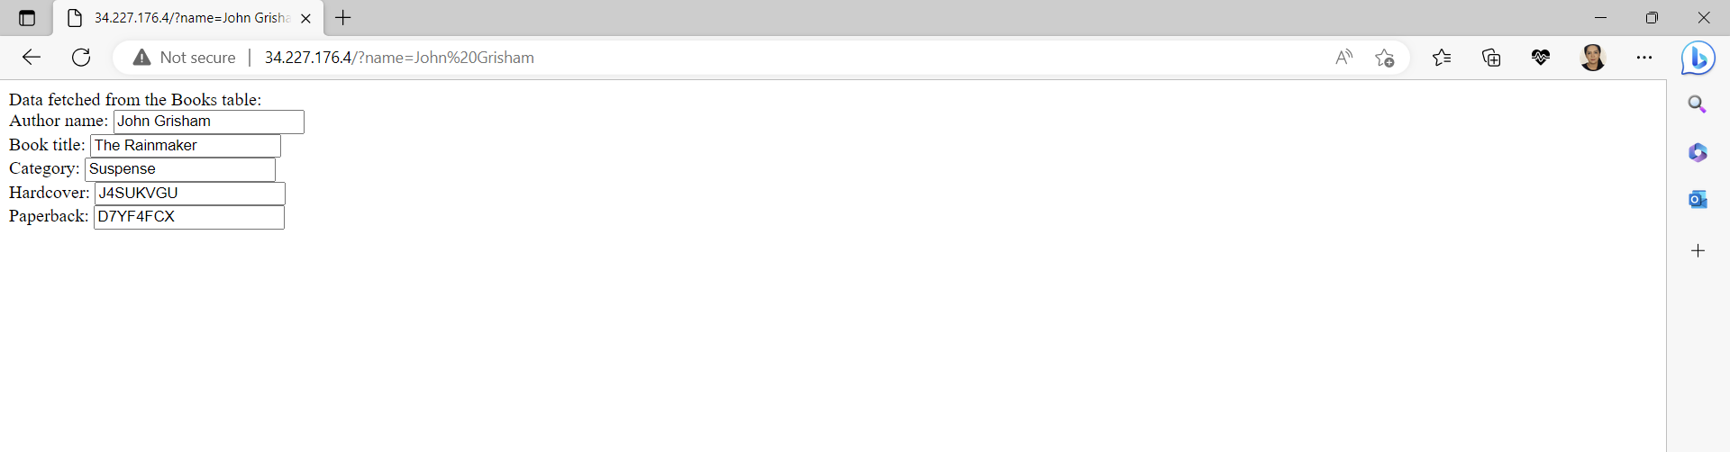
Browser shows the output of DynamoDB scan
On browser
Output after fetching data from the DynamoDB table

Slide 16
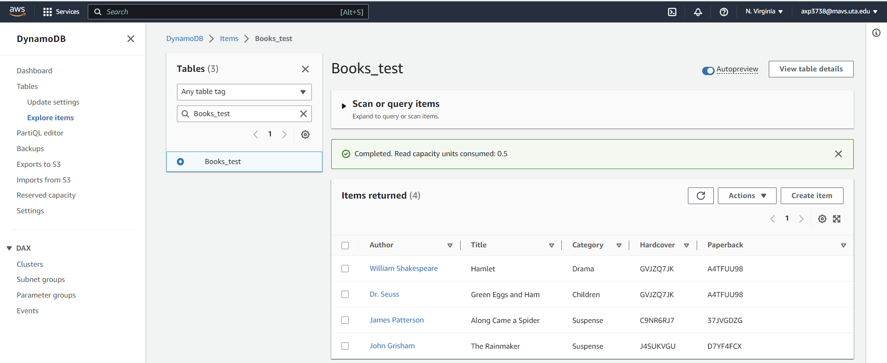
Verify correct data is fetched from DynamoDB table
Inside AWS

Slide 17
References:
https://docs.aws.amazon.com/sdk-for-javascript/v2/developer-guide/dynamodb-example-table-read-write.html
https://www.htmlelements.com/docs/grid-with-dynamodb/
https://www.youtube.com/watch?v=PuuWRfCa668
https://www.youtube.com/watch?v=a9hvw701GOI
https://www.tabnine.com/code/javascript/functions/aws-sdk/DocumentClient/get

